Slide 1
Medicale
Blockchain, Oracles & Interoperability
Mark Tharwat CS 19200164
Youssef Samir CS 19200261
Ezz Muhammad CS 19100568
Wassim Ahmed CS 19200268
Yousef Ibrahim CS 19103405
Graduation Project
Defense II
Arab Academy for Science, Technology, & Maritime Transport
Superbised by
Prof. Aymad Adel

Slide 2
Table of Contents
1
3
5
Problem Overview
Proposed Work & Diagrams
Performance Evaluation
2
4
6
Motivation & Objectives
Conclusion & Future Work
Related Work & Contributions

Slide 3
Introduction

Slide 4
Introduction
The Problem
1
FRAUDULENT ACTIVITIES INVOLVING FORGERY
2
PRIVACY BREACHES ON HEALTHCARE DOCUMENTS
Current
Health Care
Systems
3
DECENTRALIZATION IN TERMS OF MEDICAL RECORDS
4
UNETHICAL PRACTICES COMPROMISING INTEGRITY
https://www.justice.gov/criminal-fraud/hcf-2020-takedown/case-descriptions
https://www.insurance.ca.gov/0400-news/0100-press-releases/anthemcyberattack.cfm

Slide 5
Motivation
Collaborative Vision
Addressing Inefficiencies
Patient-Centric Approach
Contribution to Transformation
Improve collaboration among pharmacies, health insurance companies, and medical practitioners.
The current state of healthcare involves disjointed systems and isolated information
Aim to Streamline prescriptions, pharmacy claims, and insurance processes.
Usher in a new era of secure, efficient healthcare management.

Slide 6
Objectives [1/8]
Blockchain Utilization
Our approach involves the deliberate incorporation of blockchain technology to establish a robust, secure, and decentralized ledger system. This implementation aims to proficiently manage a spectrum of critical aspects within the healthcare domain, encompassing patient information and transactions. Notably, the utilization of blockchain serves as a safeguard mechanism, ensuring the confidentiality and integrity of sensitive identifiers, such as patient and doctor IDs. This forward-thinking application underscores our commitment to advancing the security and efficiency standards in healthcare information management.

Slide 7
Objectives [2/8]
Enabling Interoperability
Establish a resilient interoperability framework through the integration of oracles, aiming to guarantee secure authentication and standardized communication among diverse healthcare stakeholders. This implementation not only facilitates seamless interaction but also works towards eliminating silos and breaking down communication barriers that may hinder effective collaboration within the healthcare ecosystem. The incorporation of oracles plays a pivotal role in orchestrating a harmonized environment, fostering a more integrated and efficient exchange of information among various entities involved in healthcare, ultimately enhancing the overall quality of patient care.

Slide 8
Objectives [3/8]
Seamless Integration
Establish a cohesive and intricately interwoven ecosystem, promoting seamless collaboration among pharmacies, health insurance companies, and medical practitioners. The overarching objective is to cultivate a dynamic environment that encourages transparent communication and enhances the efficiency of healthcare processes. Through this collaborative framework, we aim to create a unified platform where all stakeholders collaboratively contribute to the seamless and efficient delivery of healthcare services, ensuring a holistic and patient-centric approach to healthcare management.

Slide 9
Objectives [4/8]
Insurance Leakage Mitigation
Through the utilization of blockchain and oracles to eliminate instances of insurance leakage, with the overarching goal of ensuring precise processing of insurance claims and minimizing financial losses for both patients and insurance providers. This initiative involves the implementation of sophisticated tools and protocols aimed at early detection of potential issues in the insurance claims process. By doing so, our objective is to not only safeguard the financial interests of patients but also to fortify the stability of insurance providers, fostering a secure and efficient ecosystem for insurance claim management within the realm of healthcare.

Slide 10
Objectives [5/8]
Enhanced Security Measures
Tackling inherent security vulnerabilities within centralized healthcare systems involves prioritizing the protection of patient information. This initiative aims to establish a resilient defense against potential breaches, systematically identifying and fortifying existing security loopholes. By implementing advanced security measures, our primary objective is to create a secure environment that minimizes the risk of unauthorized access, ensuring the integrity of patient information within the centralized healthcare infrastructure. This comprehensive approach underscores our commitment to advancing and maintaining the highest standards of cybersecurity in healthcare.

Slide 11
Objectives [6/8]
Transaction Monitoring
Implement sophisticated monitoring mechanisms to actively track and analyze healthcare transactions in real-time, fostering a proactive approach in identifying potential issues and guaranteeing the continuous integrity of the system. This strategic initiative aims to fortify our capabilities in real-time oversight, allowing for swift responses to emerging challenges and contributing to the overall resilience of the healthcare transaction environment. By establishing robust monitoring protocols, we seek to elevate the efficiency and reliability of our system, ensuring that it operates seamlessly while maintaining a vigilant stance against any potential disruptions or irregularities.

Slide 12
Objectives [7/8]
Digitization
Implement comprehensive digitization of healthcare data and processes, aiming to significantly improve accessibility, diminish reliance on paperwork, and streamline the overall efficiency of data management, enabling seamless access to pertinent information for healthcare professionals. By embracing a holistic approach to digitization, we seek to not only reduce the burdens associated with traditional paperwork but also enhance the overall agility and effectiveness of healthcare data management. This transformative shift towards comprehensive digitization aligns with our vision for a modernized and technologically empowered healthcare landscape.

Slide 13
Objectives [8/8]
User-Centric Design
Emphasize the creation of intuitive and user-friendly interfaces tailored for doctors, pharmacies, and patients as a primary focus. Our objective is to provide a seamless and accessible experience throughout the entire prescription and healthcare management processes. By prioritizing user-centric design principles, we aim to enhance the ease of interaction for healthcare professionals, pharmacists, and patients alike. This strategic emphasis on user-friendly interfaces is intended to optimize efficiency, reduce friction, and ultimately contribute to a more streamlined and intuitive healthcare ecosystem.

Slide 14
Proposed Work
Diagrams

Slide 15
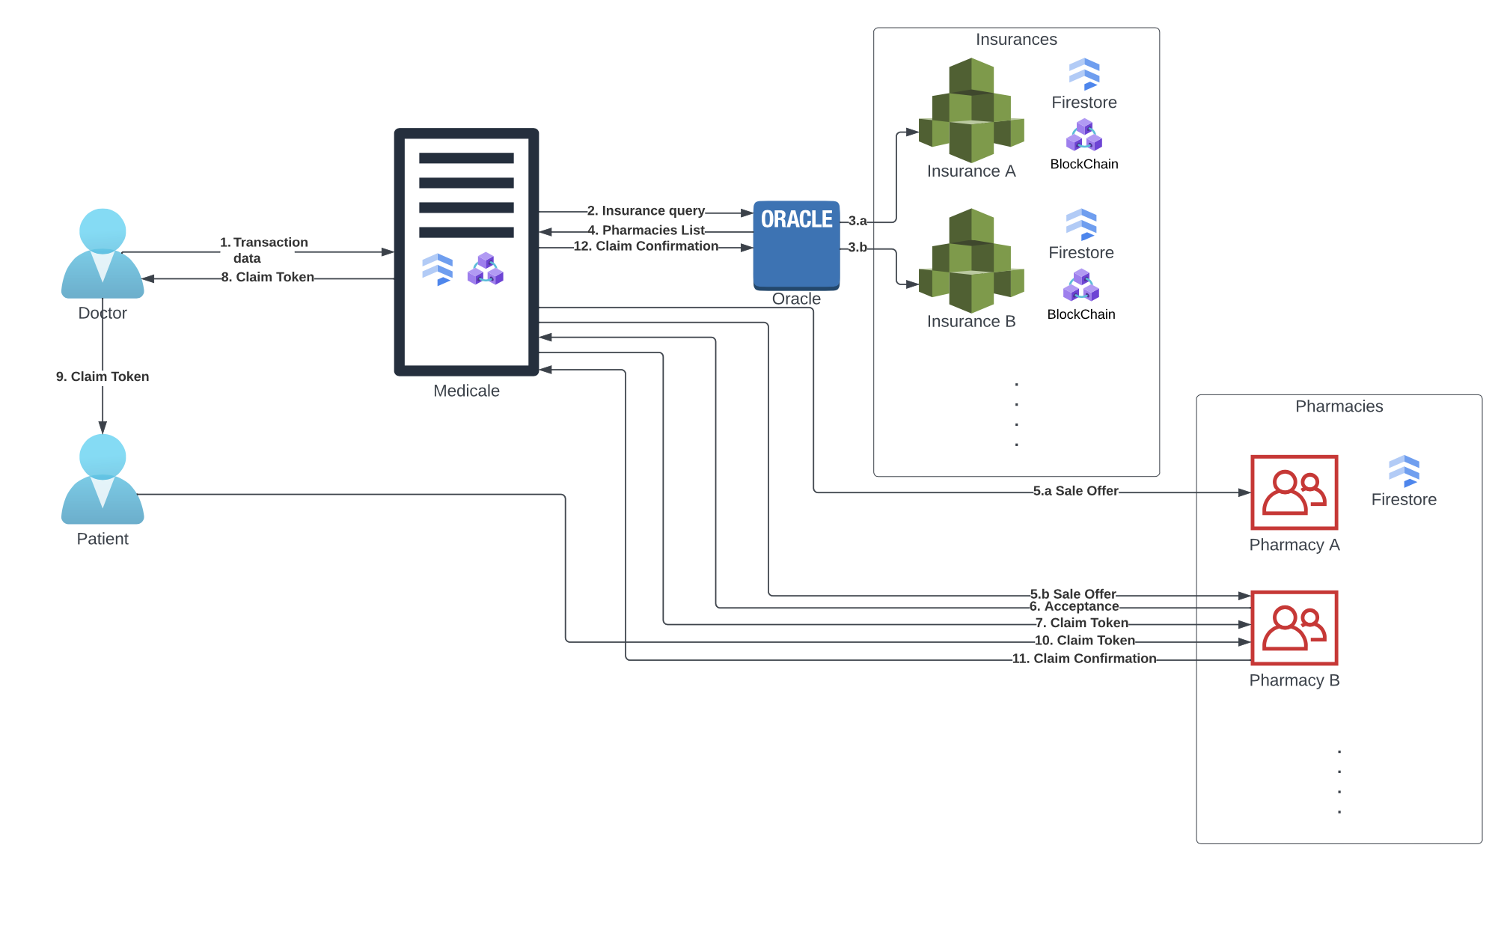
Bird’s-Eye View
The System

Slide 16
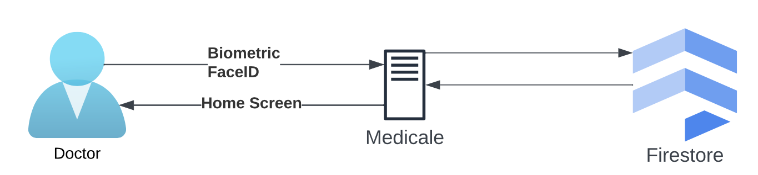
Bird’s-Eye View
Authentication

Slide 17
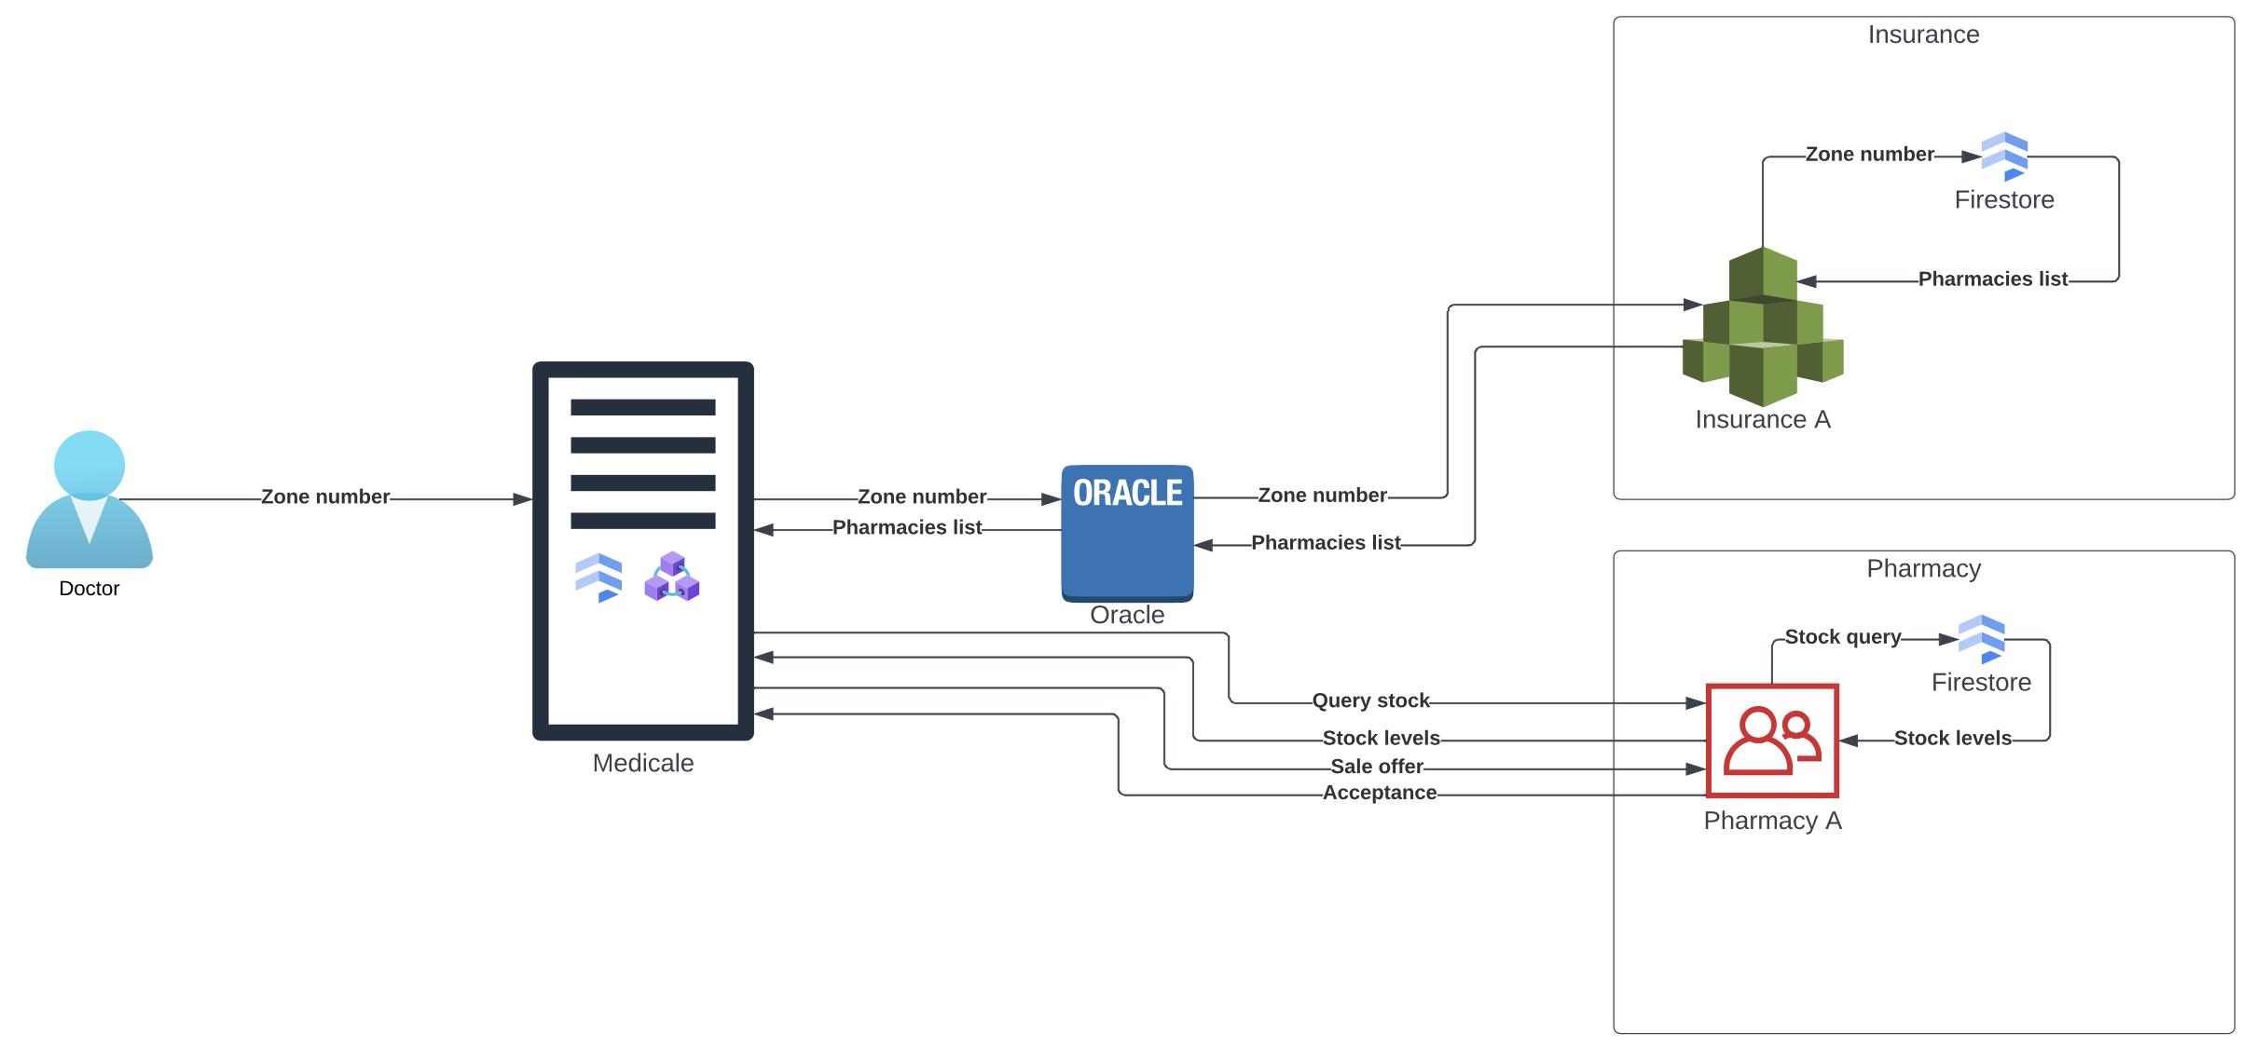
Bird’s-Eye View
Pharmacy Selection

Slide 18
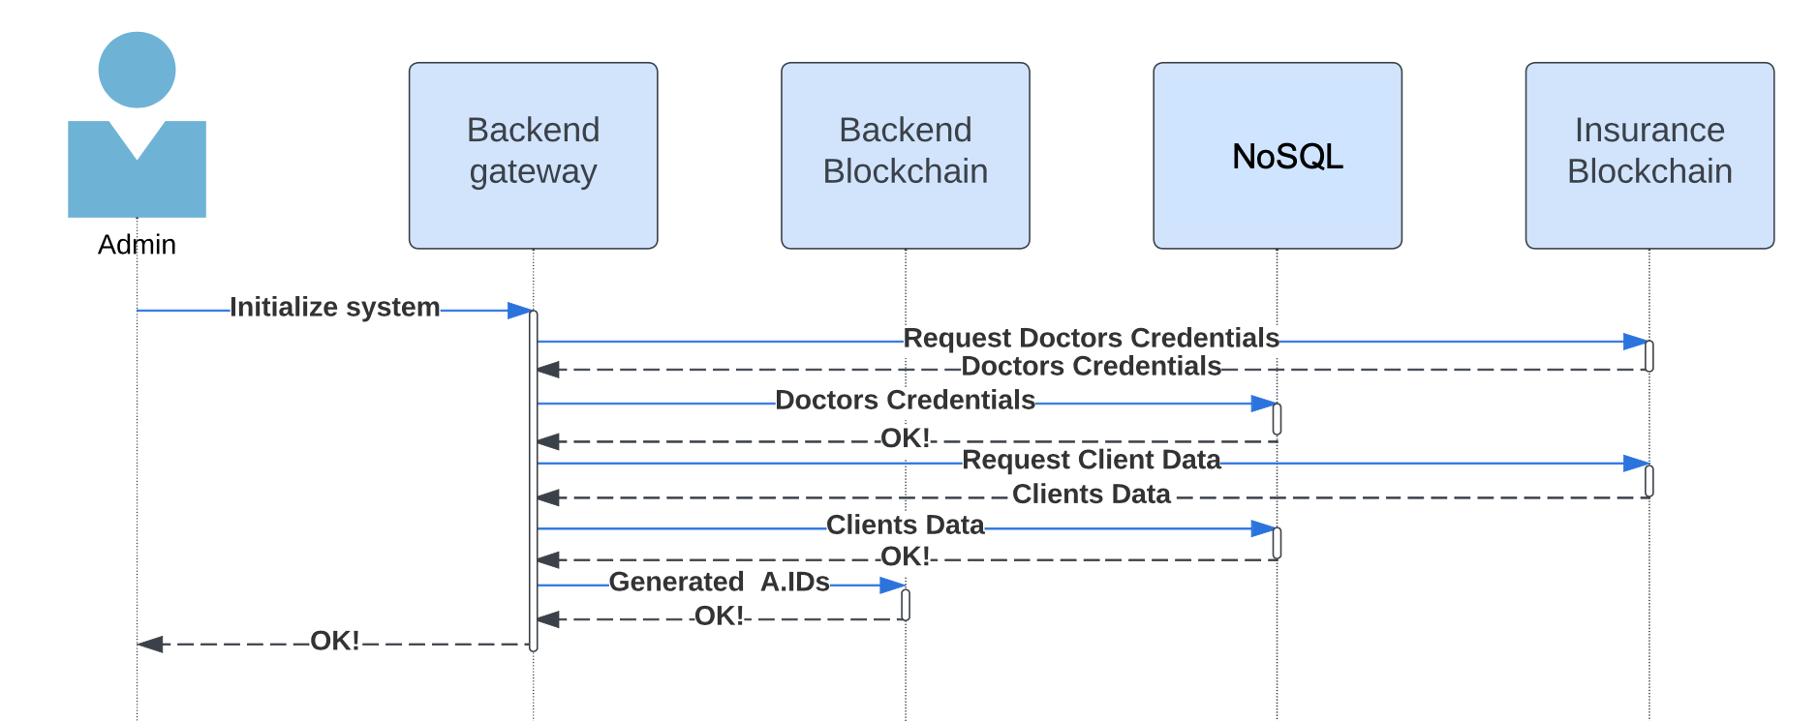
System Initialization

Slide 19
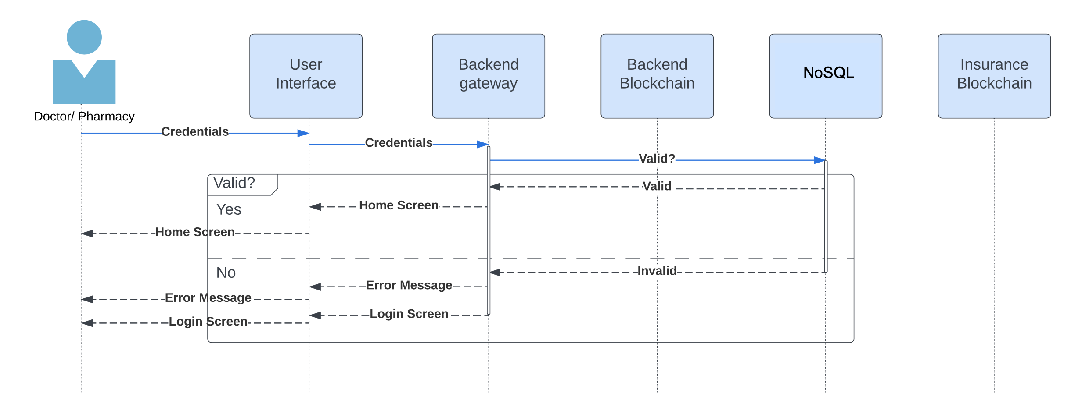
Credentials Validation

Slide 20
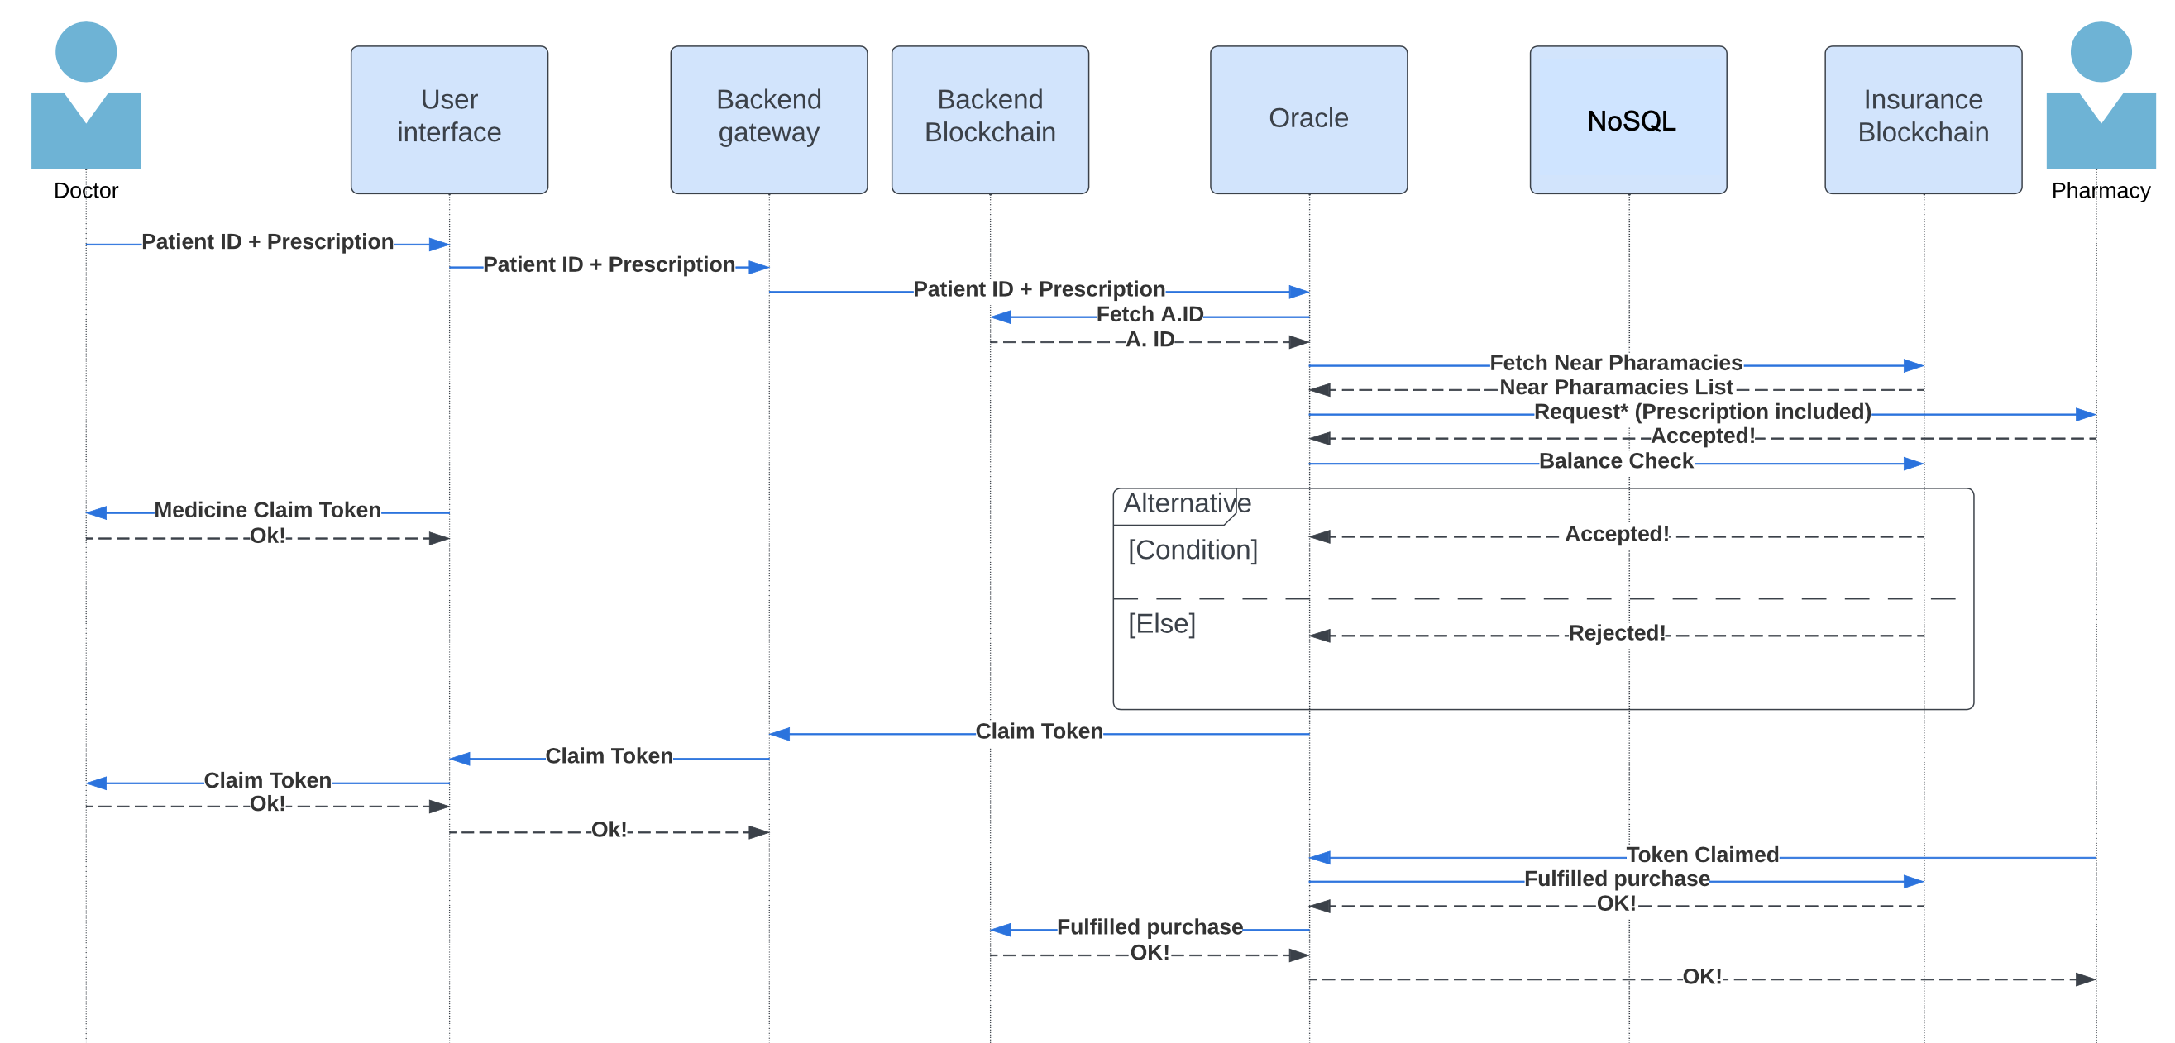
Prescription / Order

Slide 21
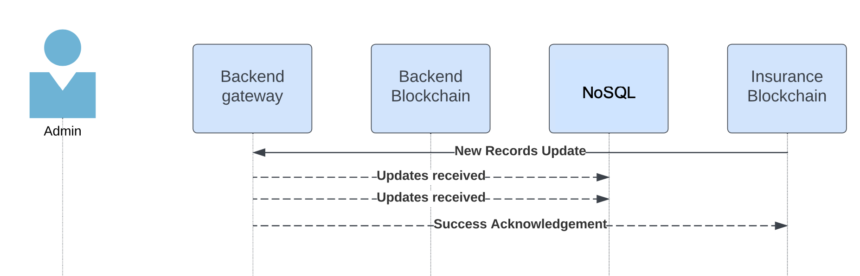
Insurance Update

Slide 22
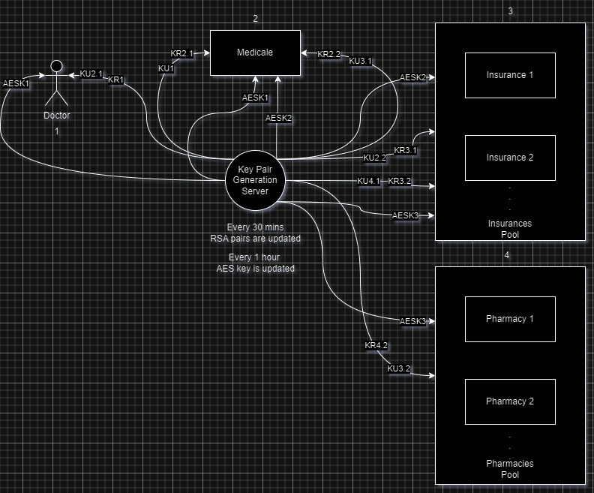
Key Server

Slide 23
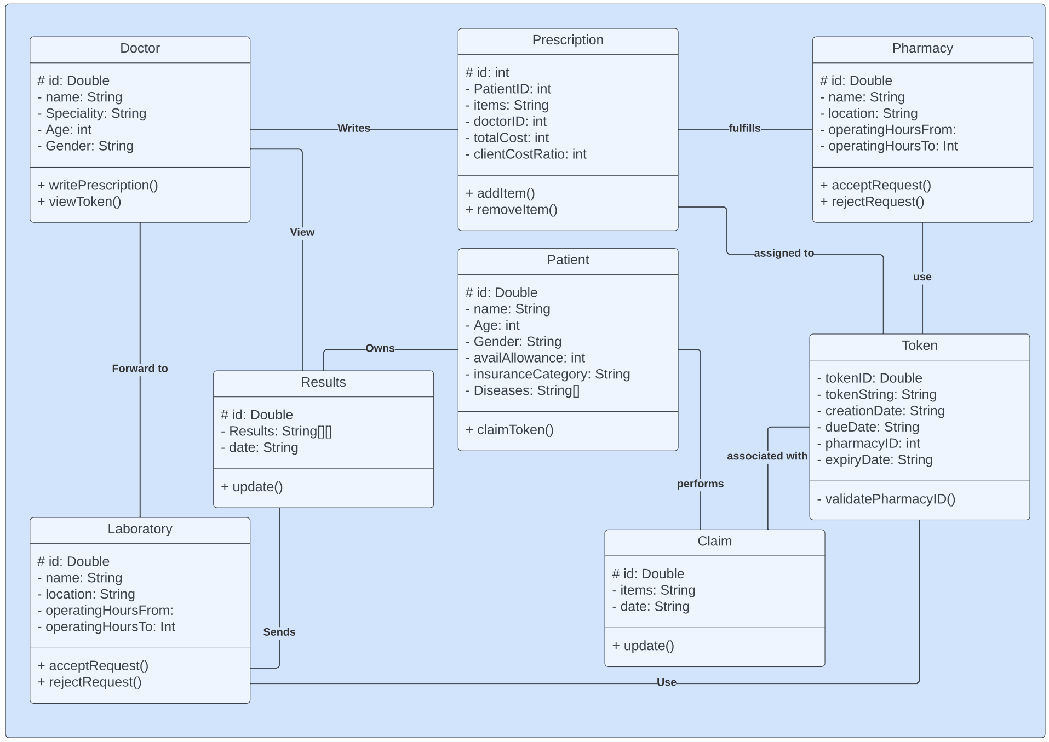
Class Diagram

Slide 24
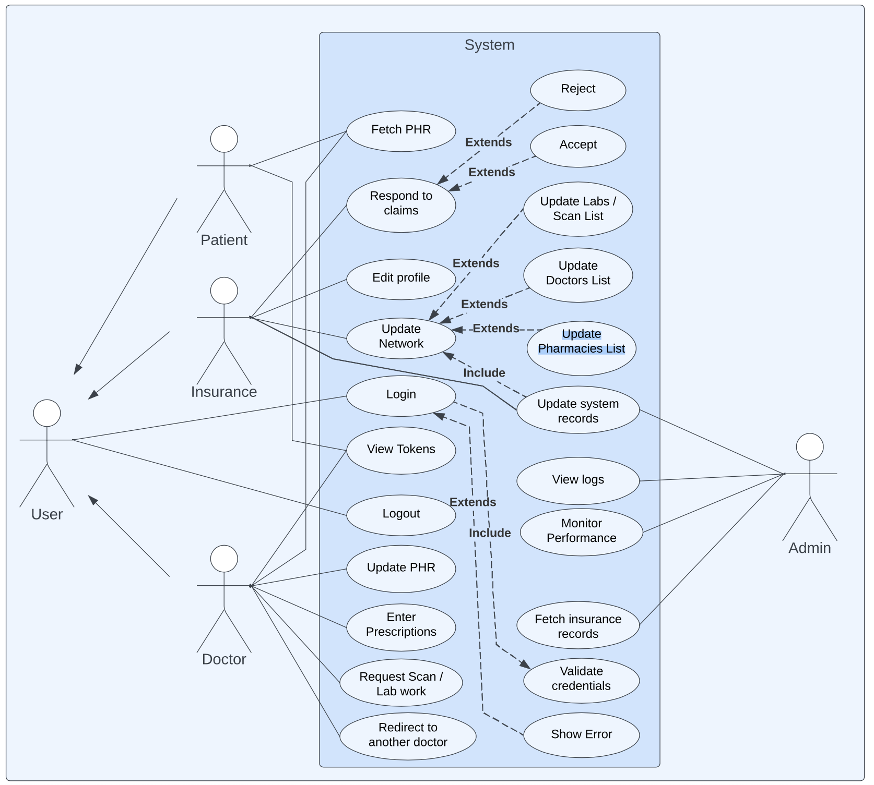
Use Case Diagram

Slide 25
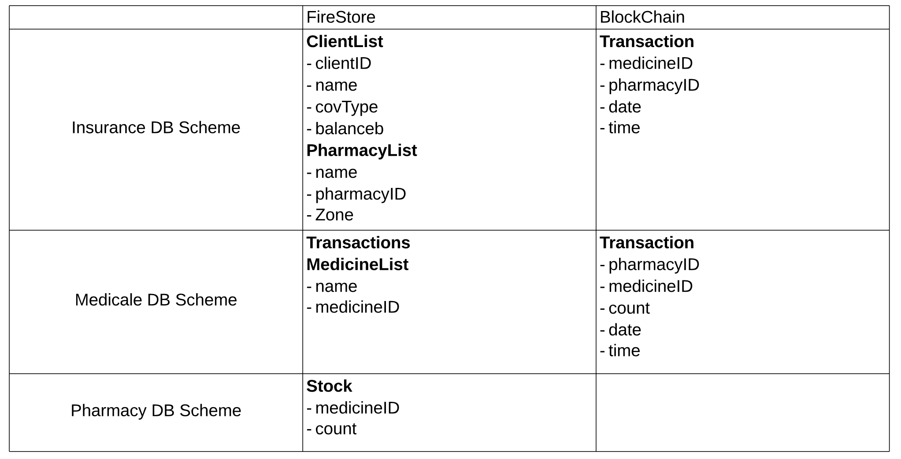
Storage Scheme

Slide 26
Related Work Comparison
Comparison
Point
Medicale
MediLedger
MIStore
Main Feature
Secure the insurance processes to ensure an anti-fraudulent environment
Secures the medical supply chain, ensuring drug legitimacy
Secure storage and verification of medical insurance information
Blockchain Utilization
Storing transaction information as well as the execution of financial deductions
Enhance the pharmaceutical supply chain’s security, privacy, and efficiency
Create medical insurance storage system.
Blockchain Technology
Ethereum
Private Permissioned Blockchain
Ethereum
Security
Protocol
AES / RSA
Cryptographic Proofs
Threshold Protocol
(t-n)-threshold
Notes:
Threshold Protocol: Implements a (t, n)-threshold protocol among servers, which means that any t servers can help the insurance company recover the desired data. This protocol is secure as long as more than n − t servers are honest

Slide 27
Security Measures [1/3]
Dataflow Encryption (AES)
Using the AES-256-CBC algorithm, encryption and decryption of JSON data are achieved. This process utilizes the Node.js crypto module for cryptographic operations. JSON data undergoes encryption by first converting it to a string, then employing AES-256-CBC encryption with the provided encryption key and initialization vector (IV). Decryption is performed using the same encryption key and IV, followed by parsing the decrypted result back into JSON format. This mechanism ensures the confidentiality and integrity of JSON data when stored or transmitted, thereby providing a secure method for handling sensitive information in applications.

Slide 28
Security Measures [2/3]
APIs Authentication
It is essential to authenticate API calls, a process achieved through an API Middleware mechanism. This mechanism involves extracting the API key from the request header and comparing it with the expected secret key. If the API key matches the expected key, the system logs a message indicating successful authorization and passes the request to the next route handler. However, if the API key does not match, the system responds with a 401 Unauthorized status and sends a JSON error message indicating unauthorized access. This middleware plays a crucial role in securing API endpoints by ensuring that only requests with a valid API key can access protected resources.

Slide 29




01
Forgery prevention
02
Contributions
Privacy breaches mitigation
03
Decentralization of medical records
04
Data integrity ensurance

Slide 30
Health Level 7
HL7 Standard
Internationally recognized set of specifications and guidelines for the electronic exchange and sharing of health-related information
Messaging
Code Systems
Support the designated HL7 message format, such as HL7 v2.x or HL7 FHIR
Use of specific vocabulary and code systems, such as SNOMED CT
Mapping
Protocols
Provide mechanisms for mapping and transforming data
Support the communication protocols specified by HL7, such as TCP/IP, or HTTP

Slide 31
Performance Evaluation

Slide 32
Performance
Evaluation
The performance of our proposed work has been tested using two simple testing methods
Blackbox testing
User acceptance testing

Slide 33
Blackbox Testing
Black-box testing is a software testing technique where the tester assesses the functionality of a system without knowledge of its internal code structure, focusing solely on inputs and outputs. Testers interact with the software as an external entity, using specified inputs and observing the resulting outputs to evaluate whether the system behaves as expected according to its requirements. This approach allows for an unbiased assessment of the software's functionality, uncovering issues related to usability, functionality, and compatibility. However, it may have limitations in test coverage and detecting certain types of defects, as testers lack visibility into the internal logic of the software. Overall, black-box testing is valuable for verifying software correctness and functionality from an end-user perspective, ensuring that it meets specified requirements and behaves as expected.

Slide 34
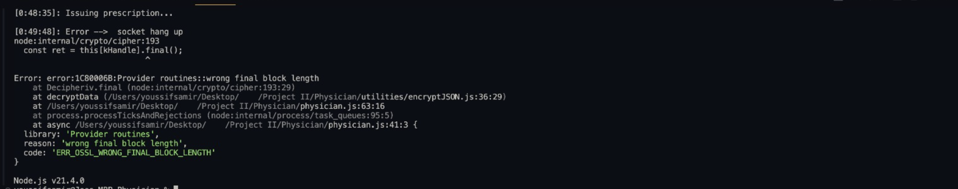
Test
One of the servers was down, resulting in a non-JSON reply to the callee. The program failed as it was not able to handle the decryption of a non-JSON entry.

Slide 35
User Acceptance Testing
User Acceptance Testing (UAT) is a software testing phase where the system is evaluated by end-users to determine whether it meets their requirements and expectations before it is deployed into production. In UAT, users interact with the software in a real-world environment, testing its functionality, usability, and overall suitability for their needs. Unlike other testing phases, UAT focuses on validating the software from the perspective of its intended users, ensuring that it aligns with their business processes and goals. Testers simulate typical usage scenarios and assess whether the software performs as expected, providing feedback and identifying any issues or discrepancies. UAT serves as the final step in the testing process, confirming that the software is ready for deployment and meets the stakeholders' approval for release.

Slide 36
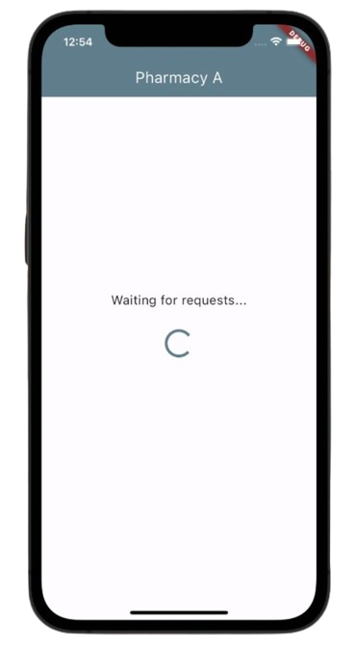
User Acceptance Testing
When the user interface was evaluated by a few end users, most of the comments were targeted at the lack of clarity regarding the type of requests being handled. users may experience uncertainty or confusion, hindering their ability to proceed efficiently. Providing more descriptive guidance on the expected request type would enhance user understanding and streamline the interaction process."

Slide 37
Conclusion &
Future Work

Slide 38
Conclusion
Healthcare Revolutionization
Blockchain Utilization
Through integration & automation emphasis
Transformation to more secure decentralized environments
Stakeholders Empowerment
Digitization
Recognition of the need for automated user-centric approaches
Through fraud proof eco-system

Slide 39
Future Work
Thorough Interoperability Testing
Stress
Testing
Implementing Local Blockchain
Utilize AWS

Slide 40
Medicale
Thank you for listening

